Slide 1
AngularJs
Aisha Usman

Slide 2
AngularJS is a client side JavaScript MVC framework to develop a dynamic web application. AngularJS was originally started as a project in Google but now, it is open source framework.
AngularJS is entirely based on HTML and JavaScript, so there is no need to learn another syntax or language.

Slide 3
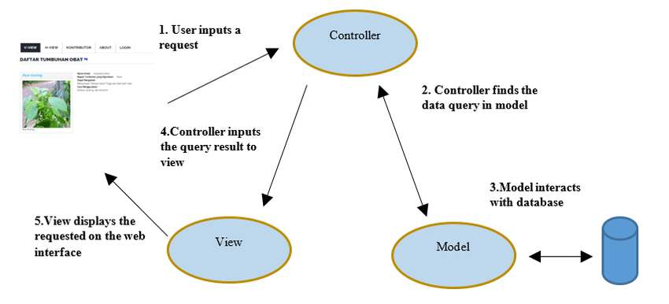

Slide 4
Advantages of AngularJS
Open source JavaScript MVC framework.
Supported by Google
No need to learn another scripting language. It's just pure JavaScript and HTML.
Supports separation of concerns by using MVC design pattern.
Built-in attributes (directives) makes HTML dynamic.
Easy to extend and customize.
Supports Single Page Application.
Uses Dependency Injection.

Slide 5
Directives
Directives are markers on a DOM element that tell AngularJS to attach a specified behavior to that DOM element or even transform the DOM element and its children. In short, it extends the HTML.
Most of the directives in AngularJS are starting with ng- where ng stands for Angular. AngularJS includes various built-in directives.

Slide 6
Expressions
Expressions are used to bind application data to HTML. Expressions are written inside double curly braces such as in {{ expression}}. Expressions behave similar to ngbind directives. AngularJS expressions are pure JavaScript expressions and output the data where they are used.
<div ng-app="">
<p>My first expression: {{ 5 + 5 }}</p>
</div>

Slide 7
Model
he ng-model directive binds the value of HTML controls (input, select, textarea) to application data.

Slide 8
DataBinding
Data-binding in AngularJS apps is the automatic synchronization of data between the model and view components.
<p ng-bind="firstname"></p>

Slide 9
AngularJs Module
An AngularJS module defines an application.
The module is a container for the different parts of an application.
The module is a container for the application controllers.
Controllers always belong to a module.
var app = angular.module("myApp", []);

Slide 10
Controller
AngularJS applications are controlled by controllers.
The ng-controller directive defines the application controller.
app.controller('myCtrl', function($scope) { $scope.firstName = "John"; $scope.lastName = "Doe"; });

Slide 11
Scope
The scope is the binding part between the HTML (view) and the JavaScript (controller).
The scope is an object with the available properties and methods.
The scope is available for both the view and the controller.

Slide 12
Filters
Filters are used to modify the data. They can be clubbed in expression or directives using pipe (|) character.

Slide 13
AngularJS Routing
The ngRoute module helps your application to become a Single Page Application.
If you want to navigate to different pages in your application, but you also want the application to be a SPA (Single Page Application), with no page reloading, you can use the ngRoute module.
The ngRoute module routes your application to different pages without reloading the entire application.

